Slide 1


Top-Down Intelligence Analysis
John Beverley
Assistant Professor, University at Buffalo
Co-Director, National Center for Ontological Research
Affiliate Faculty, Institute of Artificial Intelligence and Data Science

Slide 2
Outline
View from the Top
Basic Formal Ontology
Application to Intelligence Analysis

Slide 3
Outline
View from the Top
Basic Formal Ontology
Application to Intelligence Analysis

Slide 4
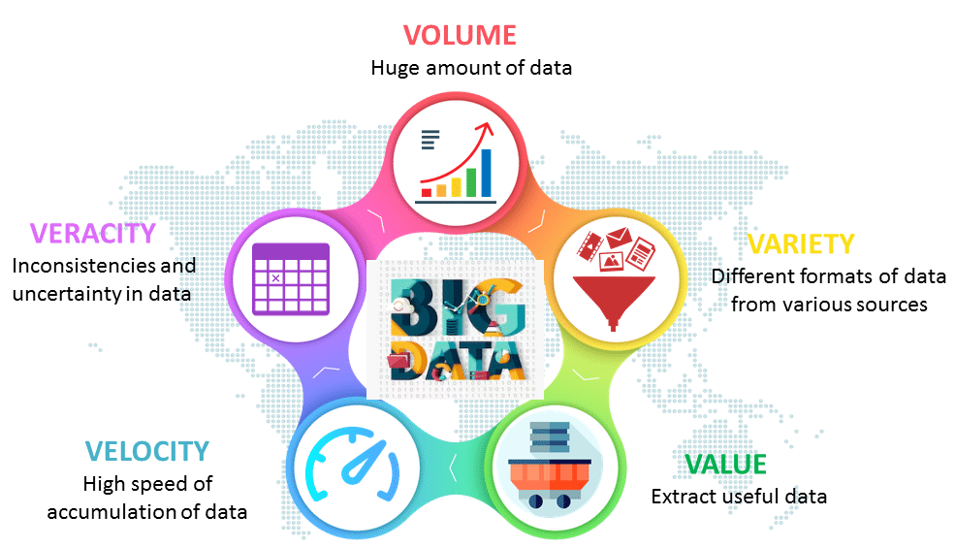
Big Data Big Problems

Slide 5
Big Data Big Problems
As of 2022, over 94
Zetabytes of data
had been stored

Slide 6
Big Data Big Problems
The volume of data generated grows
exponentially each year; as of 2020
2.5 Quintillion bytes per day

Slide 7
Big Data Big Problems
Some trustworthy, e.g. academic research
Some not trustworthy, e.g. twitter
Various standards, e.g. xml, ttl, jsonld, etc.

Slide 8
Big Data Big Problems
Conflicts invariably emerge, often between
less than trustworthy sources, but also
between trusted sources

Slide 9
Big Data Big Problems
Extracting useful information generated at such a fast clip, is challenging

Slide 10

Information Silos
An information silo is an information repository, e.g. management system, database, the content of which cannot be integrated with that of other information repositories using computing strategies
Information silos may manifest in an organization for a variety of reasons:

Slide 11
Information Silos
An information silo is an information repository, e.g. management system, database, the content of which cannot be integrated with that of other information repositories using computing strategies
Information silos may manifest in an organization for a variety of reasons:
Ignorance – Do not realize a given information repository exists

Slide 12
Information Silos
An information silo is an information repository, e.g. management system, database, the content of which cannot be integrated with that of other information repositories using computing strategies
Information silos may manifest in an organization for a variety of reasons:
Ignorance – Do not realize a given information repository exists
Inaccessible – Do not have the appropriate permissions to access

Slide 13
Information Silos
An information silo is an information repository, e.g. management system, database, the content of which cannot be integrated with that of other information repositories using computing strategies
Information silos may manifest in an organization for a variety of reasons:
Ignorance – Do not realize a given information repository exists
Inaccessible – Do not have the appropriate permissions to access
Infeasible – Do not have the appropriate technology to access

Slide 14
Information Silos
An information silo is an information repository, e.g. management system, database, the content of which cannot be integrated with that of other information repositories using computing strategies
Information silos may manifest in an organization for a variety of reasons:
Ignorance – Do not realize a given information repository exists
Inaccessible – Do not have the appropriate permissions to access
Infeasible – Do not have the appropriate technology to access
Insane – Do not care about integrating with other repositories

Slide 15
Promise of Ontology Engineering
Ontologies are formally well-defined controlled vocabularies designed to represent entities and logical relationships among them:
Exhibit standardized syntax/semantics, which helps address VARIETY
In logical languages facilitating consistency, which helps address VERACITY
Queryable for information and inferences, which helps address VALUE
Provide a lingua franca across data silos, which helps address VOLUME

Slide 16
Group Exercise
Gather into small groups and reflect how ontologies might address VARIETY, VALUE, VERACITY, and VOLUME, but not VELOCITY
In particular, I would like your group to establish each member understands big data problems and information silos, then explore how ontologies might address such concerns
We will discuss your results as a group

Slide 17
Proliferation of Ontologies
When developed correctly, ontologies provide common vocabularies with common semantics across multiple domains

Slide 18
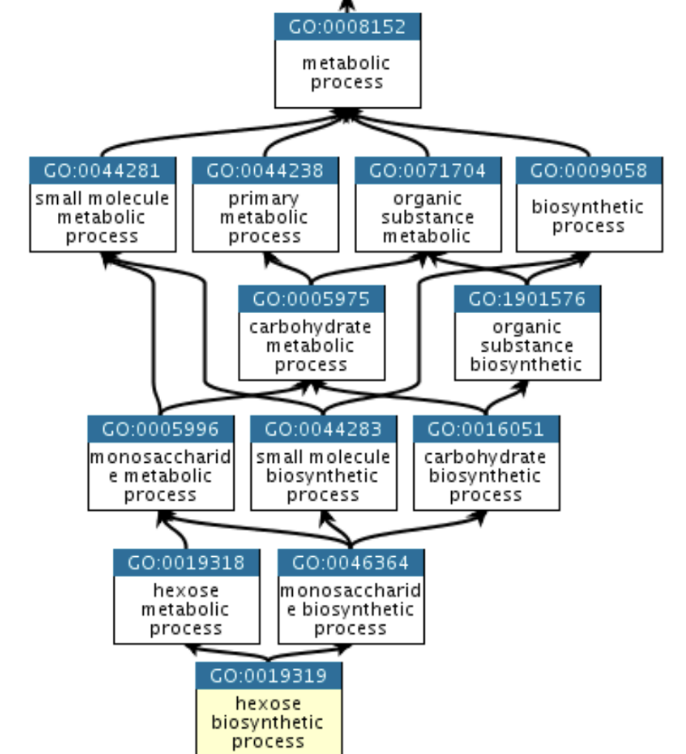

Gene Ontology - 1998
The mission of the GO Consortium is to develop a comprehensive, computational model of biological systems, ranging from the molecular to the organism level, across the multiplicity of species in the tree of life.

Slide 19
Proliferation of Ontologies
When developed correctly, ontologies provide common vocabularies with common semantics across multiple domains
The success of the Gene Ontology led to a proliferation of ontologies developed by subject-matter experts, computer scientists, and logicians

Slide 20
Proliferation of Ontologies
When developed correctly, ontologies provide common vocabularies with common semantics across multiple domains
The success of the Gene Ontology led to a proliferation of ontologies developed by subject-matter experts, computer scientists, and logicians
Almost none of which were developed in coordination
The result was massive incompatibility of terms and relations, confusion, in-fighting, name-calling, etc.

Slide 21
Group Exercise
Gather into small groups and reflect how why researchers seem disposed to create information silos, whether at the level of data or at the level of ontologies
Please consider psychological, sociological, organizational, etc. motivations and influences that may or may not result in the silos we see
We will discuss the reasons offered by your group together

Slide 22
Outline
View from the Top
Basic Formal Ontology
Application to Intelligence Analysis

Slide 23
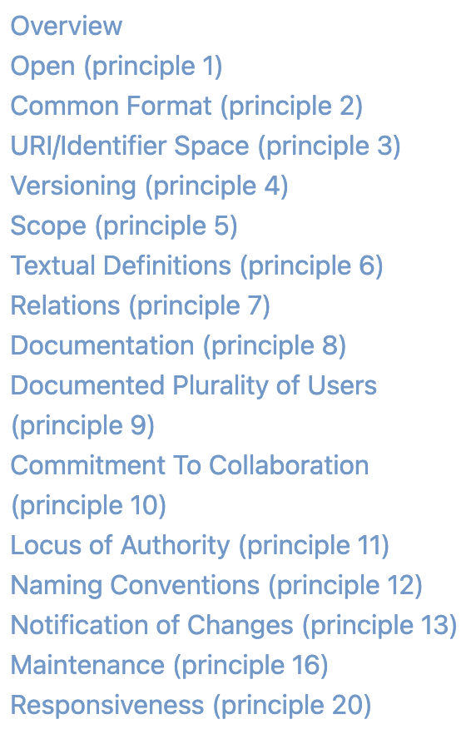
Open Biological and Biomedical Ontologies
In 2005, a consortium of biologists decided to create standards for ontology development
Such as requiring ontologies be open-source, have documentation, include definitions for vocabulary terms, and...
Align to a top-level ontology which provides a starting point for all ontology development...

Slide 24
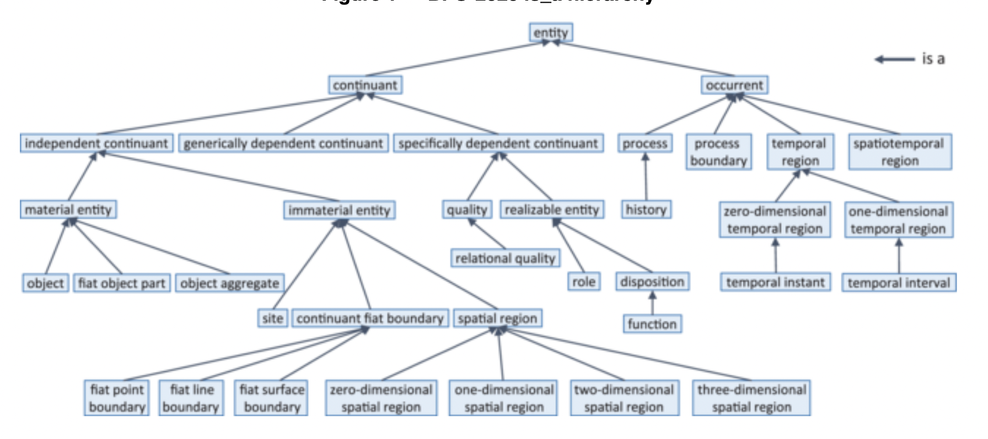
Basic Formal Ontology
BFO was adopted as that top-level architecture, and has since been adopted by other ontology Foundry efforts, such as the Industrial Ontologies Foundry

Slide 25
Using BFO as a top-level architecture, ontologies covering more specific content, e.g. livers, food, computers, etc. can extend be easily extended from it

Slide 26
Classes represent collections of instances For example: the class of tables falls under the class of objects and your dinner table would be an instance of the former
Class A is_a Class B means any instance of Class A is an instance of Class B

Slide 27

Barry Smith instance_of Agent
Material Entity
Object
CLASSES
Agent
INSTANCES

Slide 28

SUNY Professor instance_of Professor Role
Material Entity
Realizable Entity
Object
Role
CLASSES
Agent
Professor Role
INSTANCES

Slide 29
Barry Smith bearer_of SUNY Professor
Material Entity
Realizable Entity
Object
Role
CLASSES
Agent
Professor Role
INSTANCES

Slide 30
Methodological Convictions
Realism – BFO is designed to represent the world, rather than simply concepts about the world
Fallibilism – BFO is committed to tracking scientific research over time, which might change
Adequatism – BFO is non-reductive, classes and relations motivated by research communities are not ‘paraphrased away’ for example

Slide 31
Group Exercise
Gather into small groups and reflect on the methodological convictions of BFO
In particular, consider motivations for and arguments against adopting these convictions for a top-level ontology
We will examine the results of your group together

Slide 32
Outline
View from the Top
Basic Formal Ontology
Application to Intelligence Analysis

Slide 33
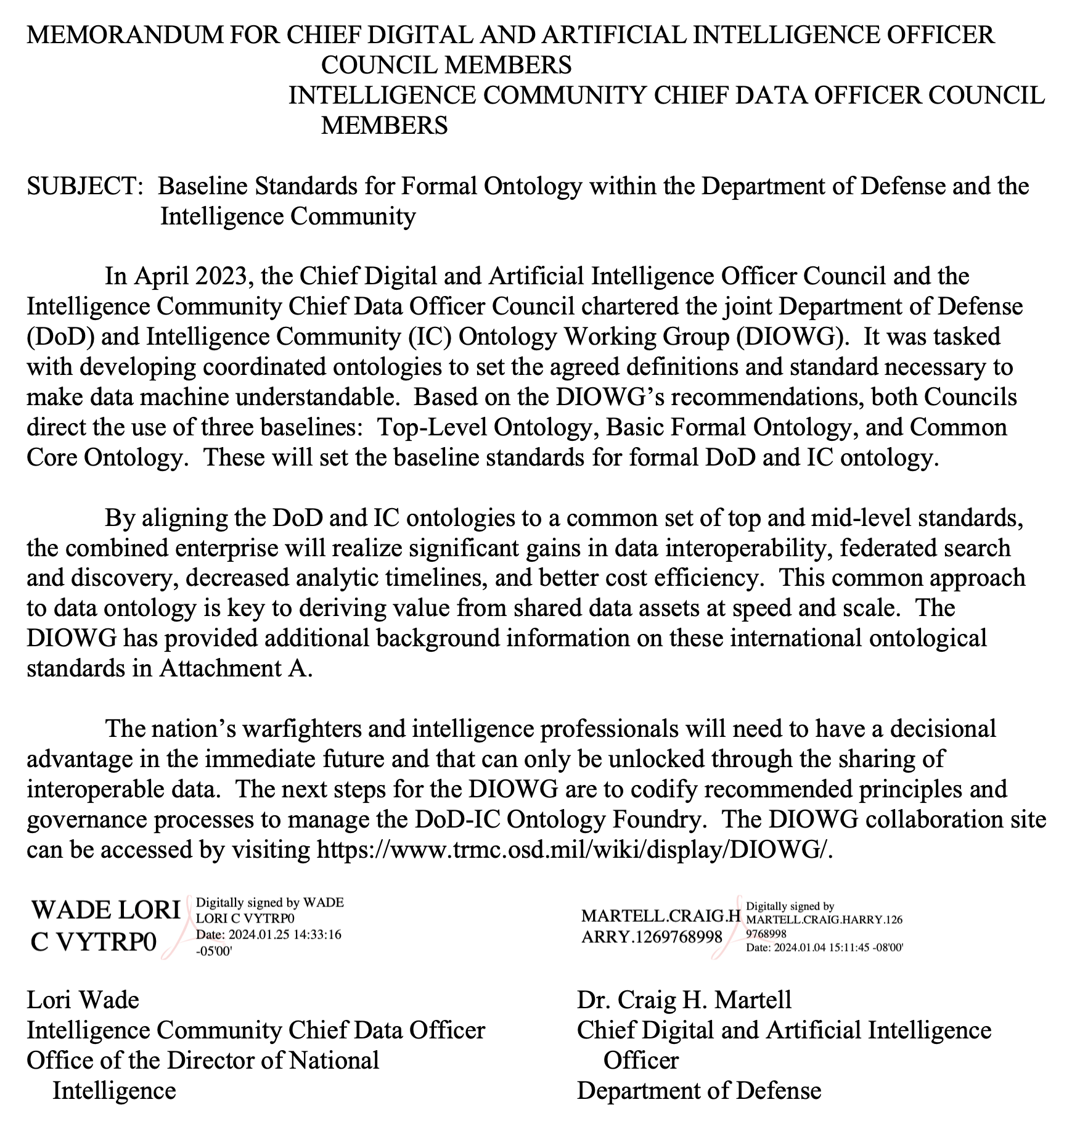
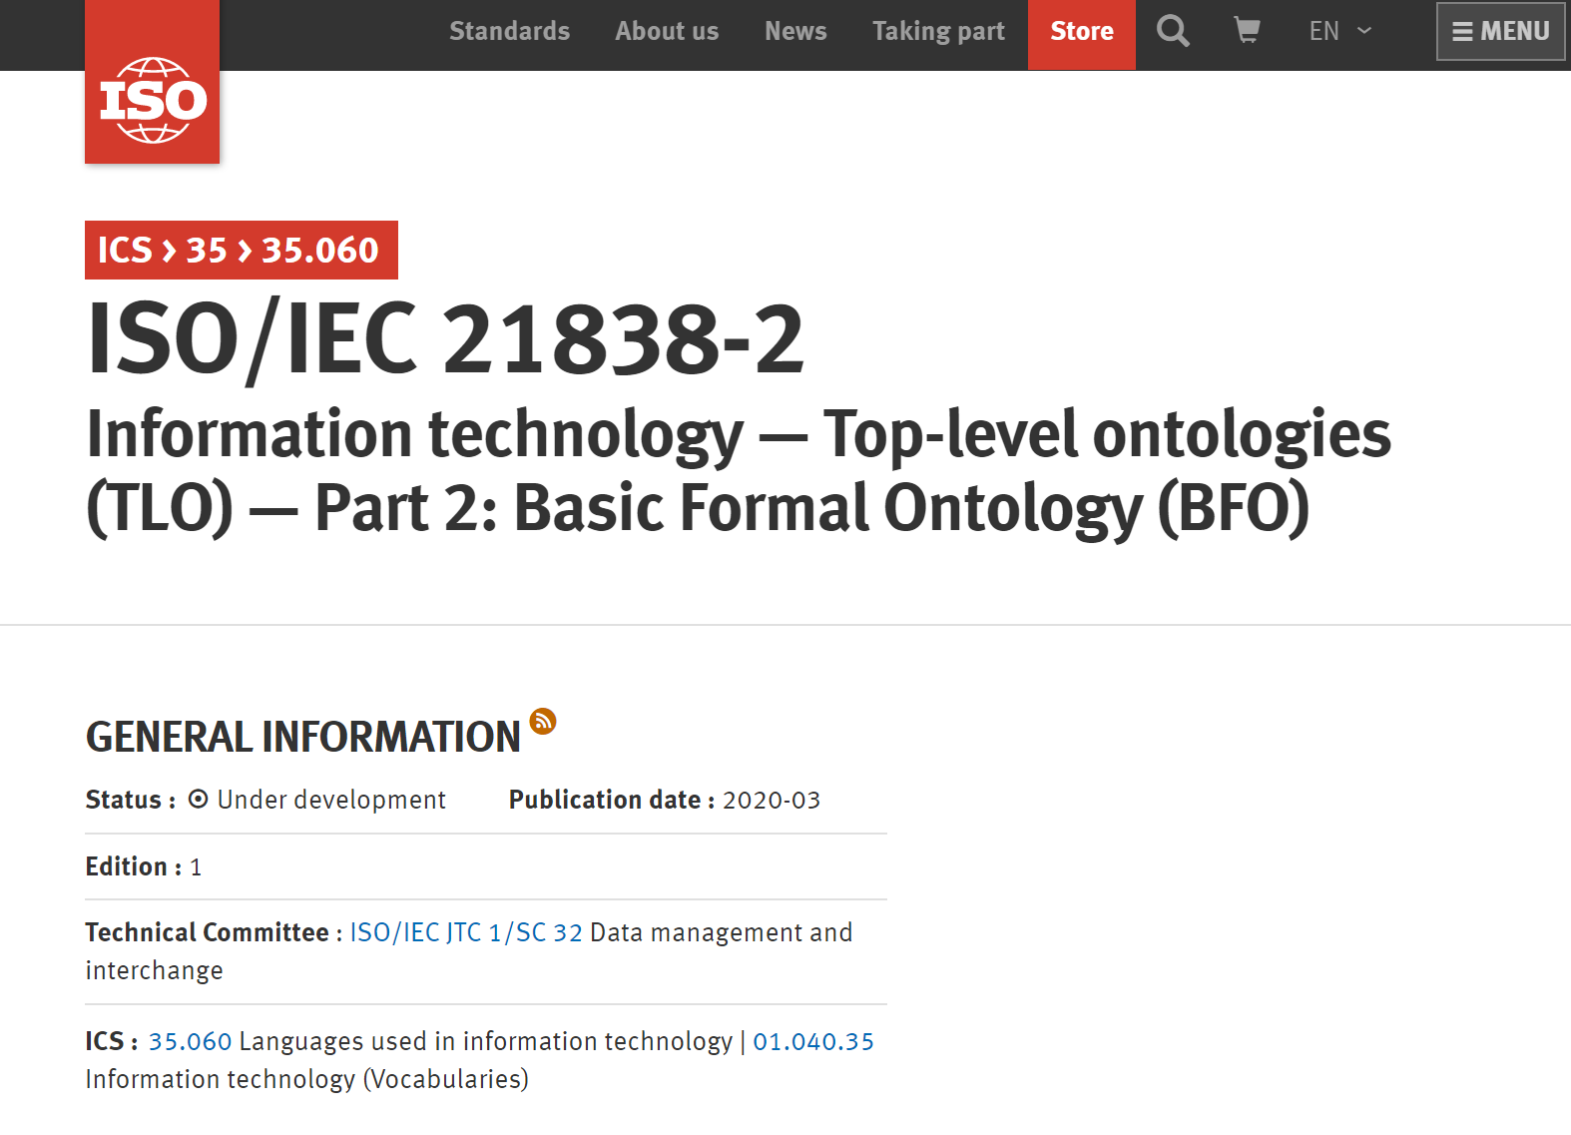

Slide 34
U.S. Government Groups Actively Relying on BFO
U.S. Customs and Border Protection
U.S. Immigration and Customs Enforcement
Defense Intelligence Agency
The United States Army
Office of the Director of Intelligence
U.S. Coast Guard
The United States Air Force
Transportation Security Administration
Department of Homeland Security
Defense Intelligence Ontology Working Group
Department of Defense and Intelligence Community
National Geospatial-Intelligence Agency
Organizing Group
LEGEND
Mitre
JHU/APL
Government Contractor
Basis Path
CUBRC
Raytheon
Lockheed Martin
Governing Organization
SAIC
Government Agency

Slide 35
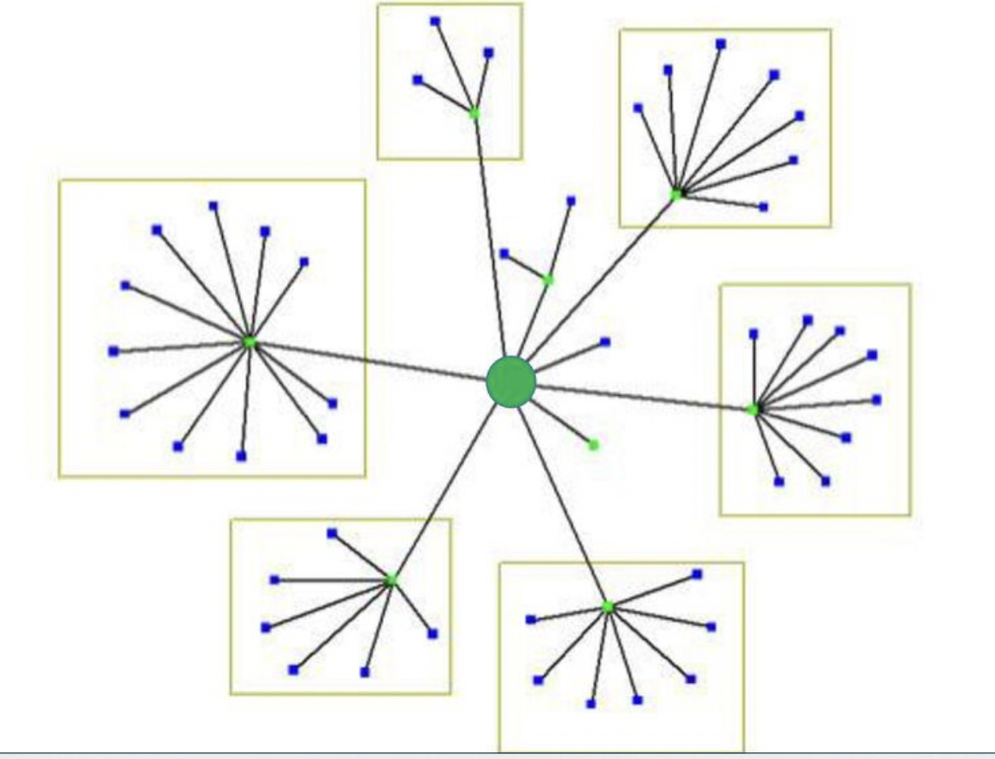
Hub & Spoke Strategy
Ontologies extending from BFO – such as OBO ontologies – are modules in a larger hub & spoke structure
Ontologies are extended by downward population, new classes have parent classes in a hierarchy ultimately leading to a BFO class
BFO

Slide 36
The Common Core Domain Ontologies
Basic Formal Ontology
Core Ontologies
Agent
Artifact
Currency
Event
Extended Relation
Geospatial
Information Entity
Modal Relation
Quality
Time
Units of Measure
Domain Ontologies
Aircraft
Aircraft Maintenance
Army Universal Task List
Atmospheric Feature
Cyber
Design
Hydrographic Feature
Legal and Criminal Act
Maintenance
Manufacturing
Military C2
Military Intelligence
Military Operation
Military Planning
Military Reports
Outer Space
Physiographic Feature
Product Lifecycle
Sensor
Spacecraft
Space Event
Spacecraft Mission
Space Object
Testing Process
Tool
Undersea Warfare
Watercraft
Key:
Joint Doctrine Ontology
Product Lifecycle Ontology

Slide 37
The Common Core Domain Ontologies
Basic Formal Ontology
Core Ontologies
Agent
Artifact
Currency
Event
Extended Relation
Geospatial
Information Entity
Modal Relation
Quality
Time
Units of Measure
Domain Ontologies
Aircraft
Aircraft Maintenance
Army Universal Task List
Atmospheric Feature
Cyber
Design
Hydrographic Feature
Legal and Criminal Act
Maintenance
Manufacturing
Military C2
Military Intelligence
Military Operation
Military Planning
Military Reports
Outer Space
Physiographic Feature
Product Lifecycle
Sensor
Spacecraft
Space Event
Spacecraft Mission
Space Object
Testing Process
Tool
Undersea Warfare
Watercraft
Key:
Joint Doctrine Ontology
Product Lifecycle Ontology

Slide 38
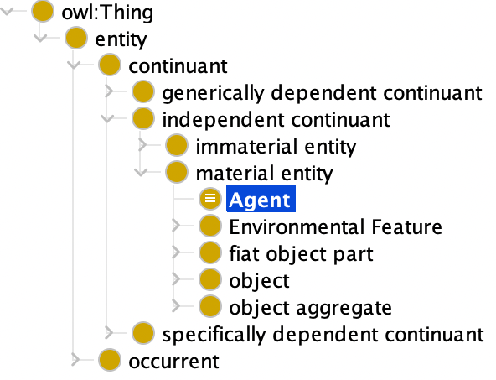
Hub & Spoke Strategy
BFO

Slide 39
Hub & Spoke Strategy
BFO

Slide 40
Material Entity & Agent
Material Entity (Elucidation) – An independent continuant that has some portion of matter as part
Agent (Definition) - A material entity that is capable of performing intentional acts

Slide 41
Material Entity & Agent
Material Entity (Elucidation) – An independent continuant that has some portion of matter as part
Agent (Definition) - A material entity that is capable of performing intentional acts
Downward population leverages the definition scheme:
A is a B that Cs
Where B is the parent class under which A falls

Slide 42
Material Entity & Agent
Material Entity (Elucidation) – An independent continuant that has some portion of matter as part
Agent (Definition) - A material entity that is capable of performing intentional acts
Downward population leverages the definition scheme:
A is a B that Cs
Where B is the parent class under which A falls

Slide 43
Material Entity & Agent
Material Entity (Elucidation) – An independent continuant that has some portion of matter as part
Agent (Definition) - A material entity that is capable of performing intentional acts
Downward population leverages the definition scheme:
A is a B that Cs
Where B is the parent class under which A falls

Slide 44
Material Entity & Agent
Material Entity (Elucidation) – An independent continuant that has some portion of matter as part
Agent (Definition) - A material entity that is capable of performing intentional acts
Downward population leverages the definition scheme:
A is a B that Cs
Where B is the parent class under which A falls

Slide 45
Material Entity & Agent
Material Entity (Elucidation) – An independent continuant that has some portion of matter as part
Agent (Definition) - A material entity that is capable of performing intentional acts
Downward population leverages the definition scheme:
A is a B that Cs
Where B is the parent class under which A falls

Slide 46
Intelligence Analysis Specific Issues
The preceding illustrates how ontologies can be used to address big data problems, as well as how ontologies can be and have been extended from BFO using a recipe
Insofar as intelligence analysis exhibits these general problems, there is a clear path for ontologies to help
There are, however, more specific issues arising in intelligence analysis that are worth investigating

Slide 47
Intelligence Analysis Solutions

Slide 48

Intelligence Analysis Solutions

Slide 49

Persistent Problems

Slide 50
Veracity & Value
These problems persist in the context of vetted, low-velocity,low-volume, similarly formatted data
Multiple intelligence agents working on a single topic may agree on the facts, but not on what conclusions should be drawn from them
The result is, in the best case, cautious conditional claims about what might be concluded

Slide 51
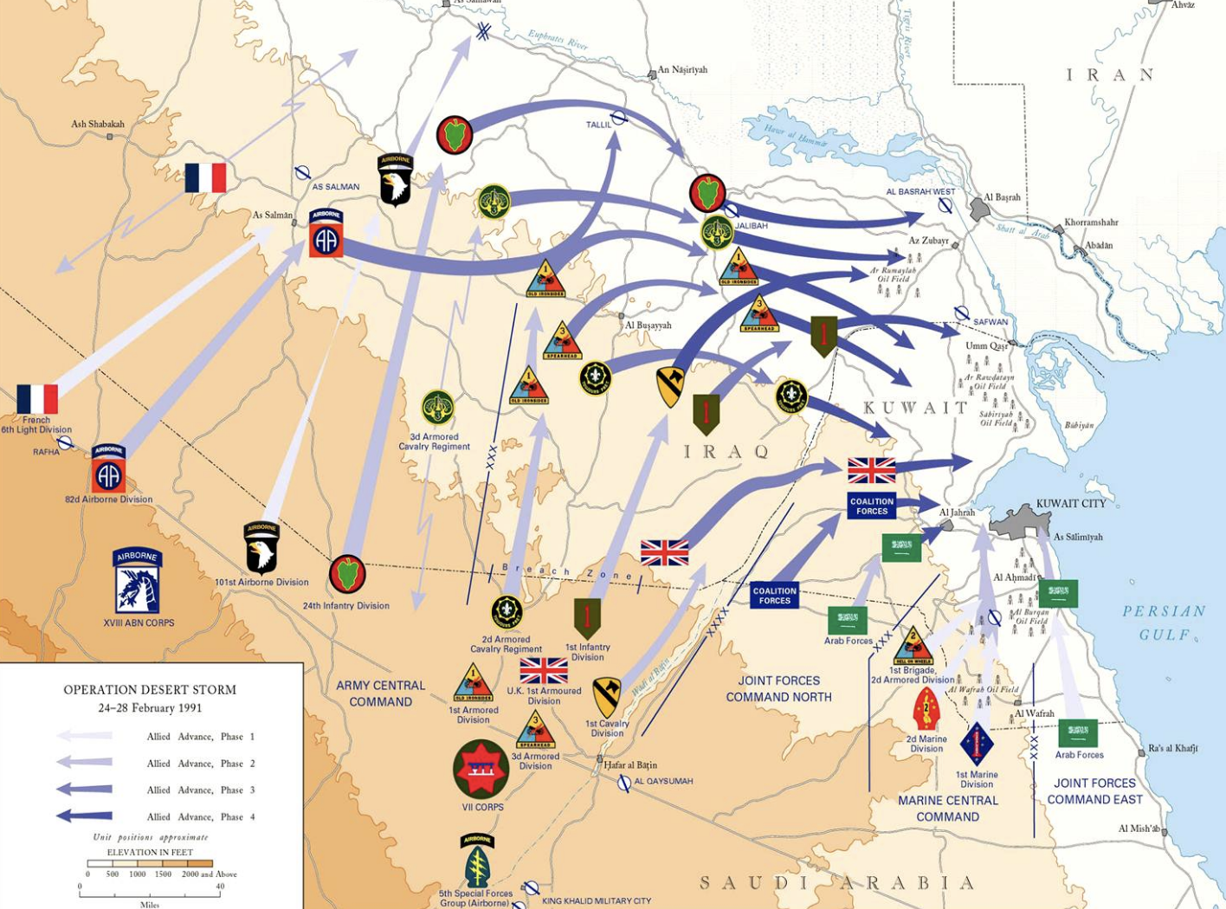
1991 Gulf War
In 1990, Iraq invaded Kuwait and leveraged weapons of mass destruction during the invasion, e.g. chemical weapons
In 1991, a coalition of nations led by the U.S. liberated Kuwait
Sanctions were imposed on Iraq; in particular, the government was required to cease research and development of weapons of mass destruction

Slide 52
2003 Invasion of Iraq
Preceding 9/11, there had been concerns over the extent to which Iraq was or was not conducting R&D on weapons of mass destruction
Following 9/11, the U.S. declared war on Iraq on the pretext that the government was conducting such research and had been involved in the attacks
Much justification was based on a U.S. National Intelligence Estimate

Slide 53
National Intelligence Estimate (NIE)
Considered to be among the most authoritative intelligence analysis documents that can be produced
Involves expert intelligence analysis input from all U.S. government intelligence agencies; is indeed signed by the directors of each agency
An NIE was producted on the topic of Iraq’s potential R&D regarding weapons of mass destruction

Slide 54
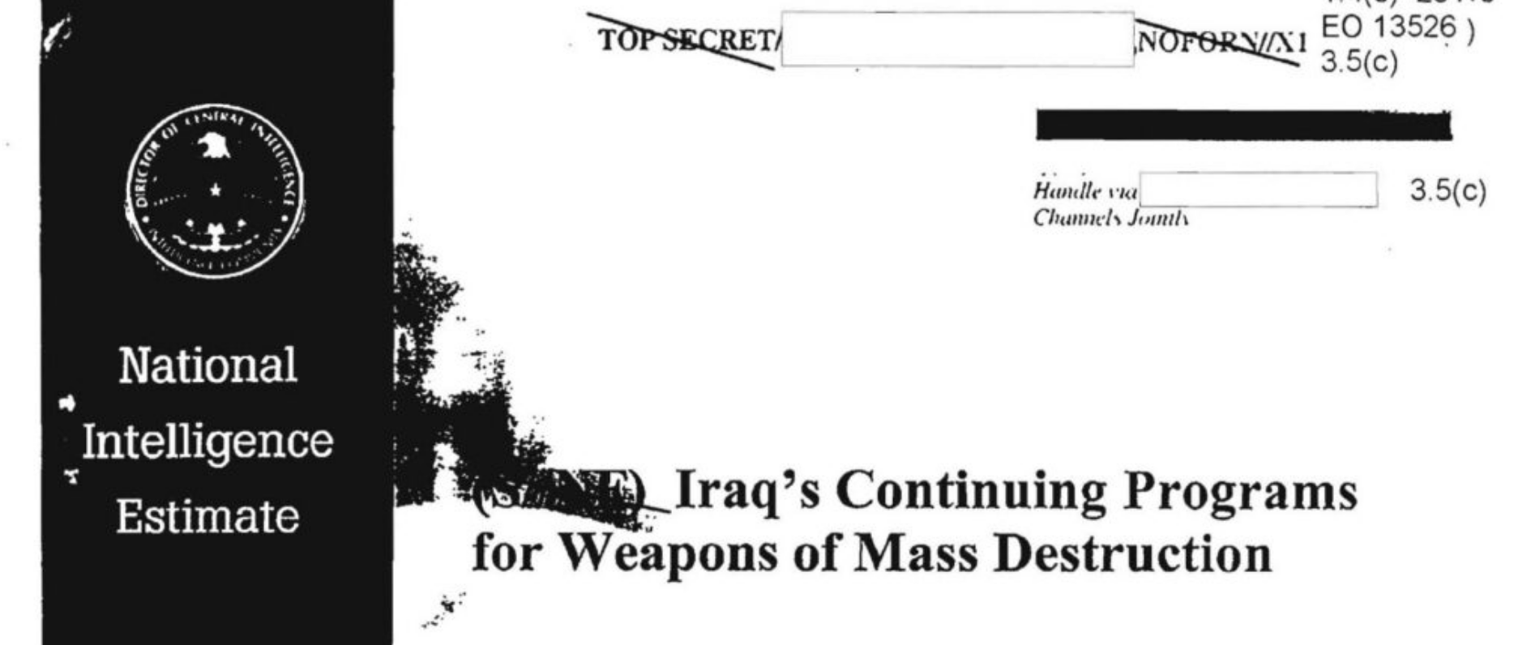
National Intelligence Estimate (NIE)
Despite stating intelligence agencies had limited information about the potential counter-intelligence in Iraq at the time, tentative conclusions were drawn that Iraq continued its weapons of mass destruction programs

Slide 55

2003 Invasion of Iraq
Secretary of State Colin Powell presented the U.S. case to the United Nations in the interest of garnering support
"My colleagues, every statement I make today is backed up by sources...What we're giving you are facts and conclusions based on solid intelligence...Saddam Hussein has chemical weapons...and Saddam Hussein has no compunction about using them again — against his neighbors, and against his own people."

Slide 56
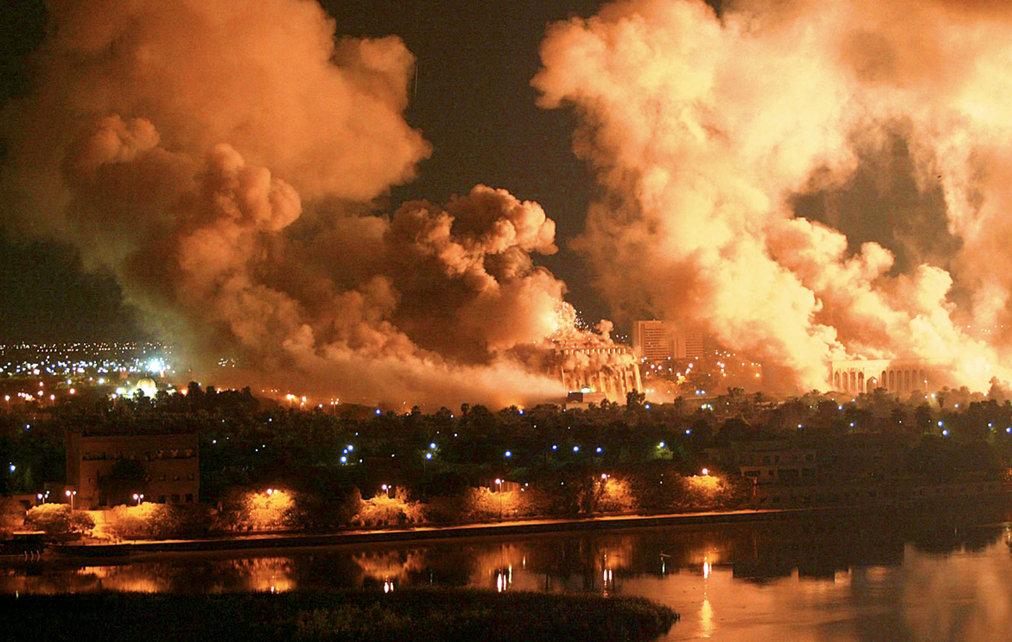
Intelligence Failure
The U.S. and coalition forces toppled the Iraq regime led by Saddam Hussein within a week; no weapons of mass destruction were found
In 1991, Hussein lied about weapon manufacturing, but following sanctions he closed down such operations
However, he did not tell the Iraqi people or his cabinet because he did not want to appear weak; he assumed U.S. intelligence was so good it would know

Slide 57
Intelligence Failure
They did not
Intelligence analysts in the U.S. believed that because Hussein had lied about weapons of mass destruction before the Gulf War, he was likely lying again
They were right that he was lying, but wrong about what he was lying about

Slide 58
Group Exercise
Gather into small groups and reflect on the intelligence failures just described from the leadup to the war in Iraq
In particular, reflect on whether and how such intelligence failures might have been mitigated or addressed by leveraging ontology strategies and technologies
Spoiler: I expect this to be a rather challenging exercise...

Slide 59
Readings
Philosophical Foundations of Intelligence Collection and Analysis
Ontology for the Intelligence Analyst

